Slide 1
Machine Learning
Machine Learning is made up of the words Machine and Learning. So
What is Machine? A machine is a thing that is created by humans to make work easier. Now, What is learning? When we say learning, we mean like something like "gaining knowledge by studying, experiencing, or being taught.“
Sharpening our focus a bit, we can think of machine learning as using algorithms for acquiring structural descriptions from data examples.

Slide 2
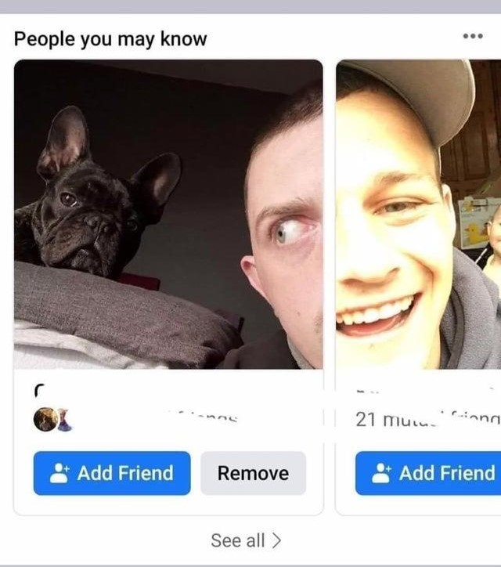
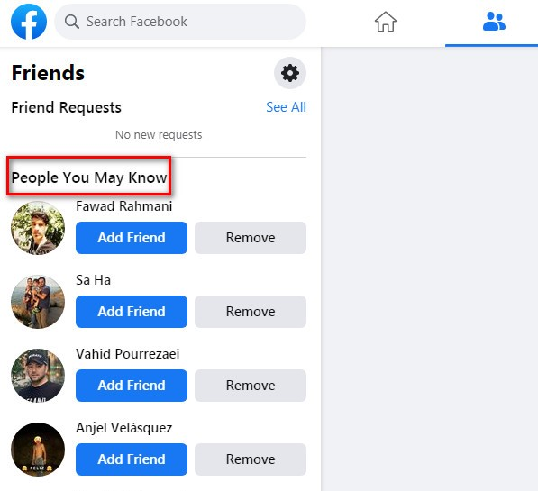
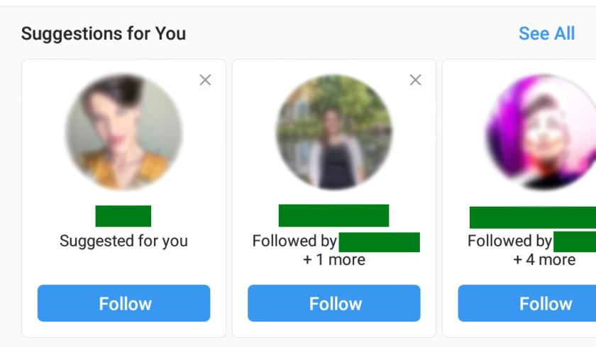
Machine Learning Involves showing a large volume of data to the machine so that it can learn and make predictions, find patterns, or classify data.
Applications of Machine Learning
Social Media Features: Friend’s suggestions and Recommending Content.

Slide 3
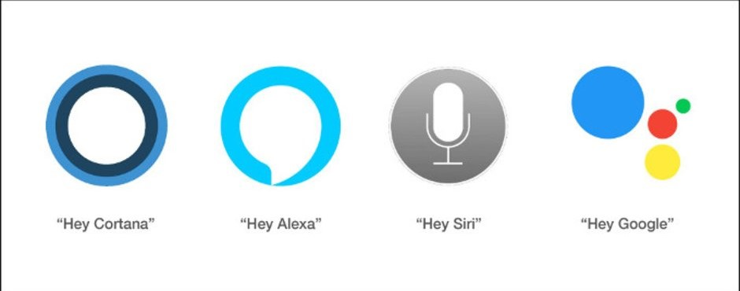
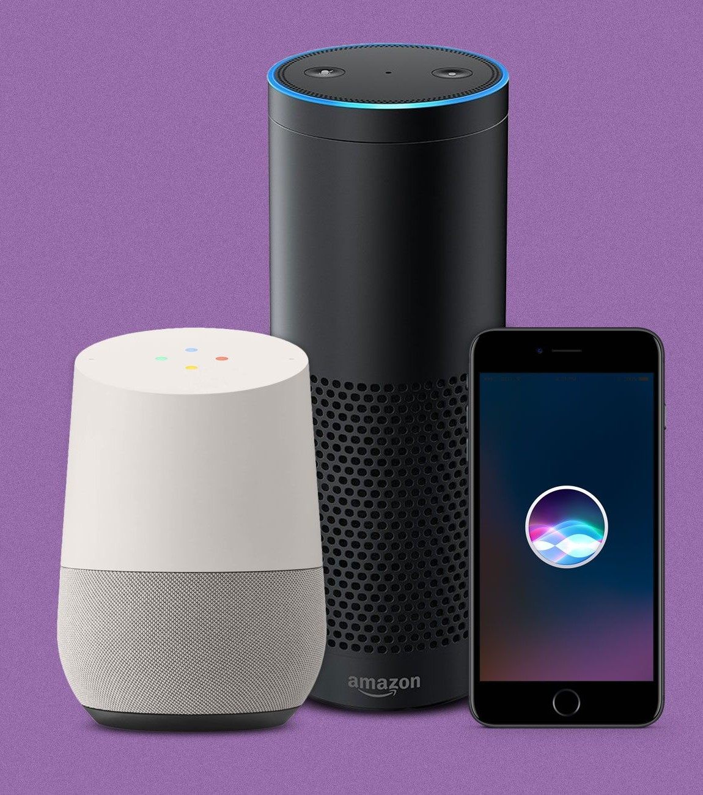
Virtual assistants: Apple's Siri, Amazon's Alexa, and Google
They Collect Information and refine it each time
You interact with them.

Slide 4
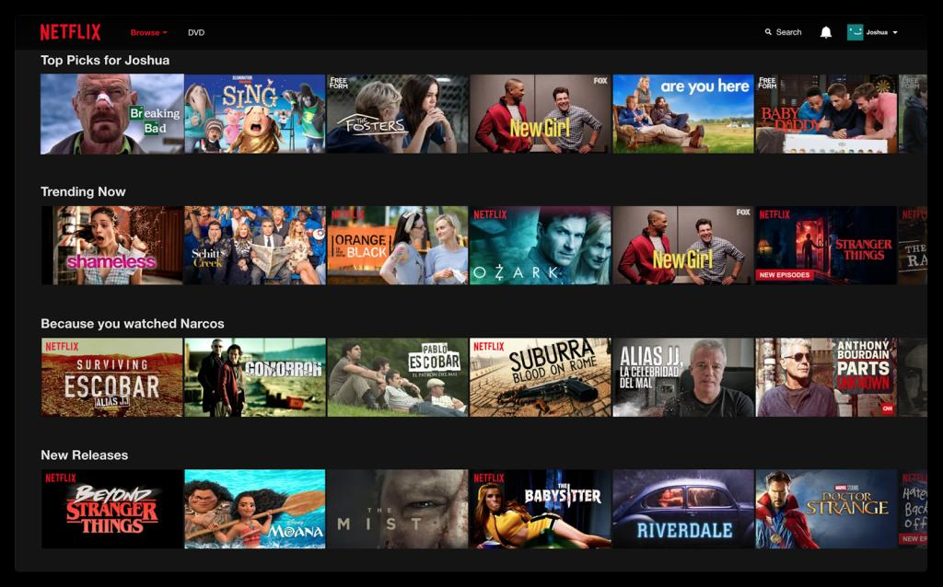
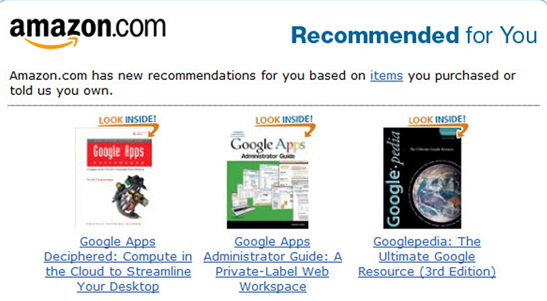
Product Recommendation and web series recommendation: On Amazon E-commerce Websites and Netflix type of websites based on user previous search data.
These websites use customer data to recommend the Netflix series according to past behavior and search.

Slide 5
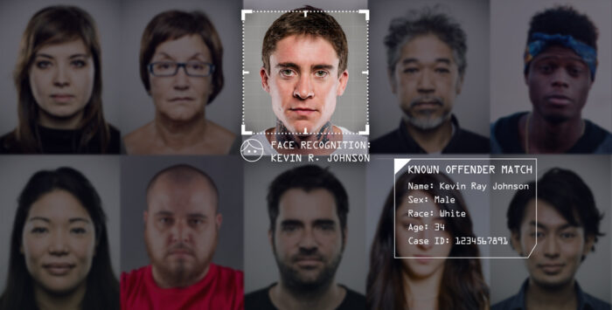
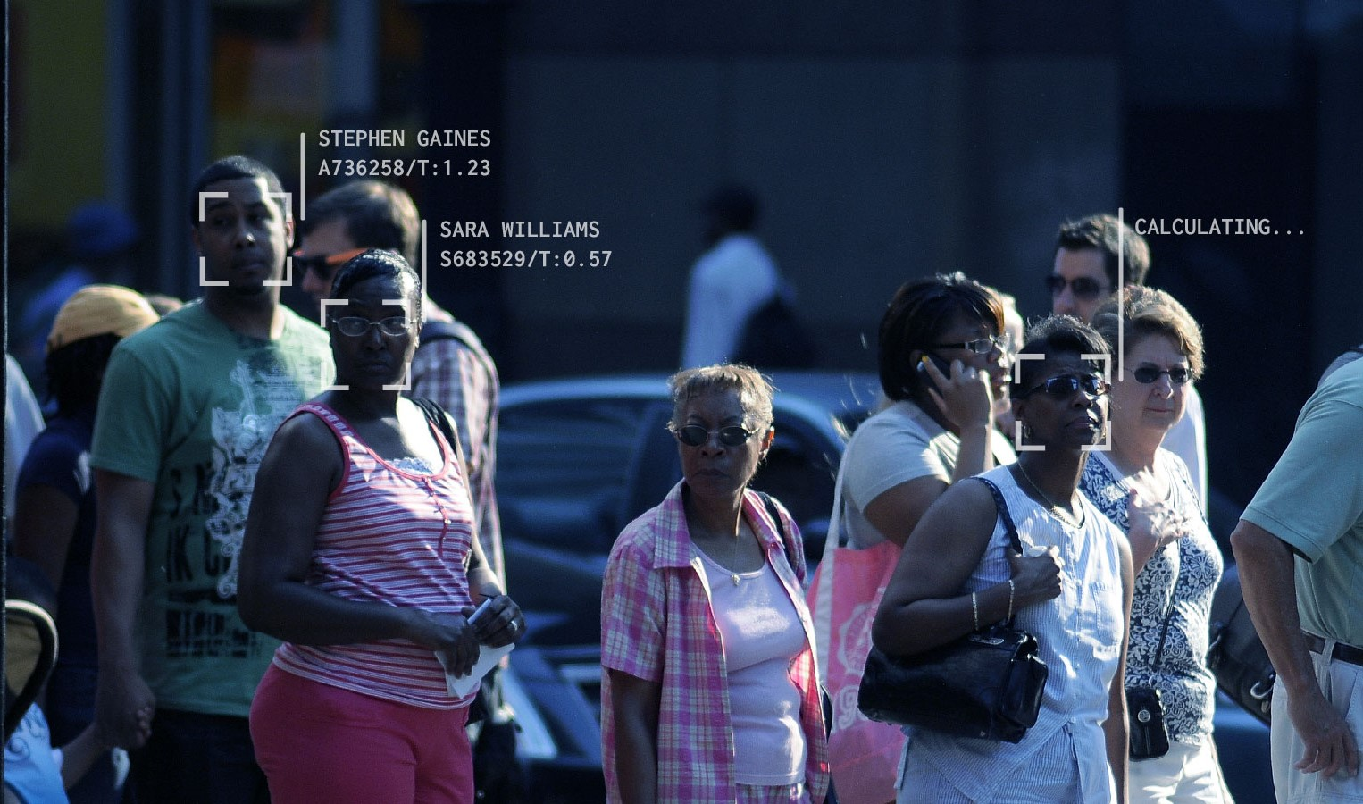
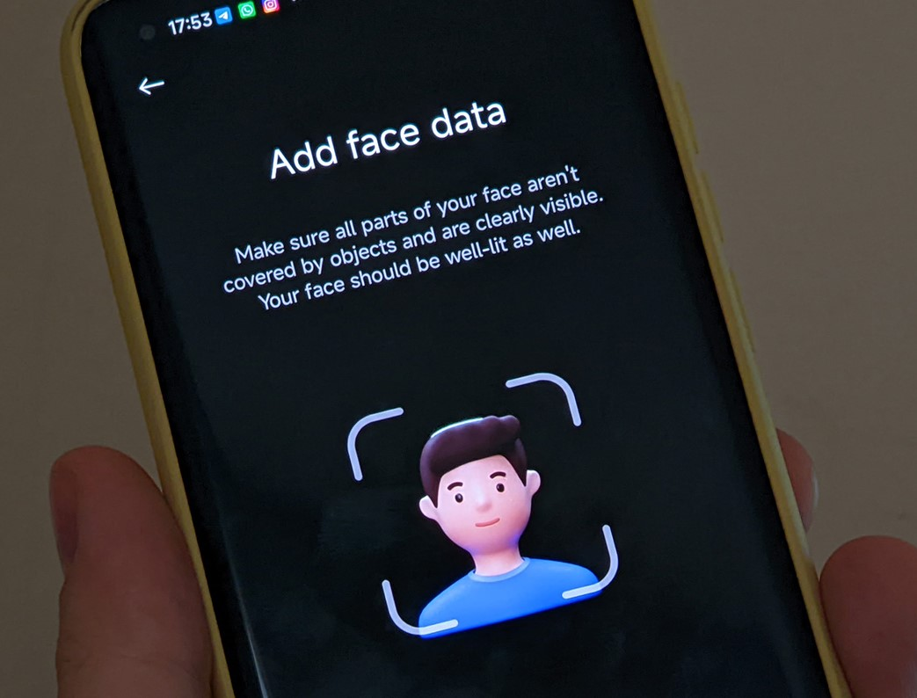
Image Recognition: It detects and recognized the faces present in the image. It is used in face recognition systems for criminal cases, finding missing people, used in social media where people tag each other, and used in security devices like unlocking phones, passwords, etc.

